Slide 1
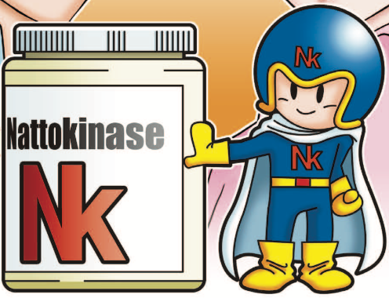
NSK-SD®
IF IT’S NOT NSK-SD®, IT’S NOT NATTOKINASE
June 2020

Slide 2
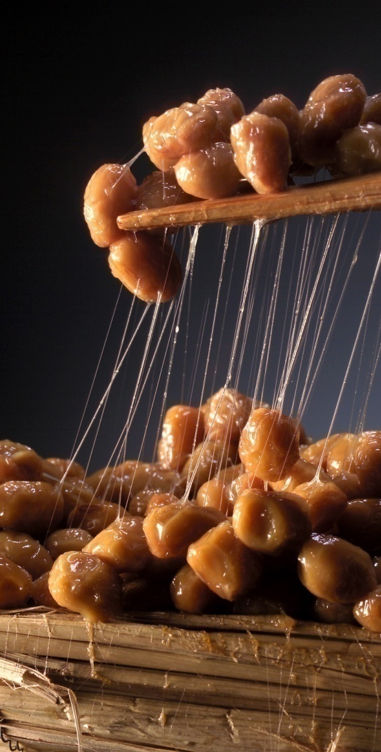
NSK-SD® and Hypertension
NSK-SD has 6 human clinical studies showing efficacy in decreasing high blood pressure.

Slide 3
Hypertension
High blood pressure increases the risk for heart disease and stroke, two leading causes of death for Americans.
High blood pressure is also very common. According to the CDC, tens of millions of adults in the United States have high blood pressure, and many do not have it under control.

Slide 4
NSK-SD® Reduces Hypertension
Human Study #1 (Krishnan 2003) – randomized, placebo-controlled, crossover study
20 individuals with variety of diseases (essential hypertension, hyper-coagulable states, auto-immune diseases and diabetes)
4,000FU NSK-SD or placebo every day for 4 weeks
RESULTS
Significant decrease in SBP compared to baseline (p=0.039)
Human Study #2 (Krishnan 2003 Part B) –
50 patients divided into high BP and normal BP groups
Placebo given first for 4 weeks, then NSK-SD for 8 weeks (4,000FU/day)
RESULTS
SBP and DBP significantly decreased in high BP patients
Neither SBP nor DBP were significantly affected by treatment in normal BP patients, which means NSK-SD is safe for those with normal BP!
Notes:
SBP – Systolic Blood Pressure
DBP – Diastolic Blood Pressure

Slide 5
NSK-SD® Reduces Hypertension
Human Study #3 (Kim 2008): Randomized, Double-blind, Placebo-controlled study
73 adults with hypertension
2,000FU/day NSK-SD for 8 weeks
RESULTS:
Significant decrease in both SBP and DBP (p<0.05)
Significant decrease in renin activity (p<0.05)
Renin is produced by kidney to increase blood pressure
Notes:
Euglobin lysis time (ELT) measures overall time it takes to break down blood clots (fibrinolysis)
Euglobulin fibrinolytic activity (EFA) measures how much area of blood clot is broken down in a set time
tPA – tissue plasminogen activator
tPA is a commonly used drug for thrombolytic therapy

Slide 6
NSK-SD® Reduces Hypertension
Human Study #4 (Lotte 2014): Randomized, Double-blind, Placebo-controlled study
42 adults with high blood pressure risk
2,000FU/day NSK-SD or KPX+olive leaf extract (competitor product) for 4 weeks
RESULTS:
NSK-SD group saw significant decrease in both SBP and DBP (p<0.001)
NSK-SD also showed significantly greater reduction in BP compared to competitor KPX

Slide 7
NSK-SD® Reduces Hypertension
Human Study #5 (Jensen 2016): Randomized, Double-blind, Placebo-controlled study
79 adults with hypertension
2,000FU/day NSK-SD for 8 weeks
Also was reanalyzed and republished in 2019 (Watanabe et al.) with 67 subjects excluding those with Stage 2 Hypertension
RESULTS:
NSK-SD group saw a significant decrease in DBP (p<0.05)
NSK-SD group saw significant decrease in von Willebrand factor, a cardiovascular risk marker linked to stroke (p<0.05)
Notes:
*not statistically significant, but saw a decreasing trend

Slide 8
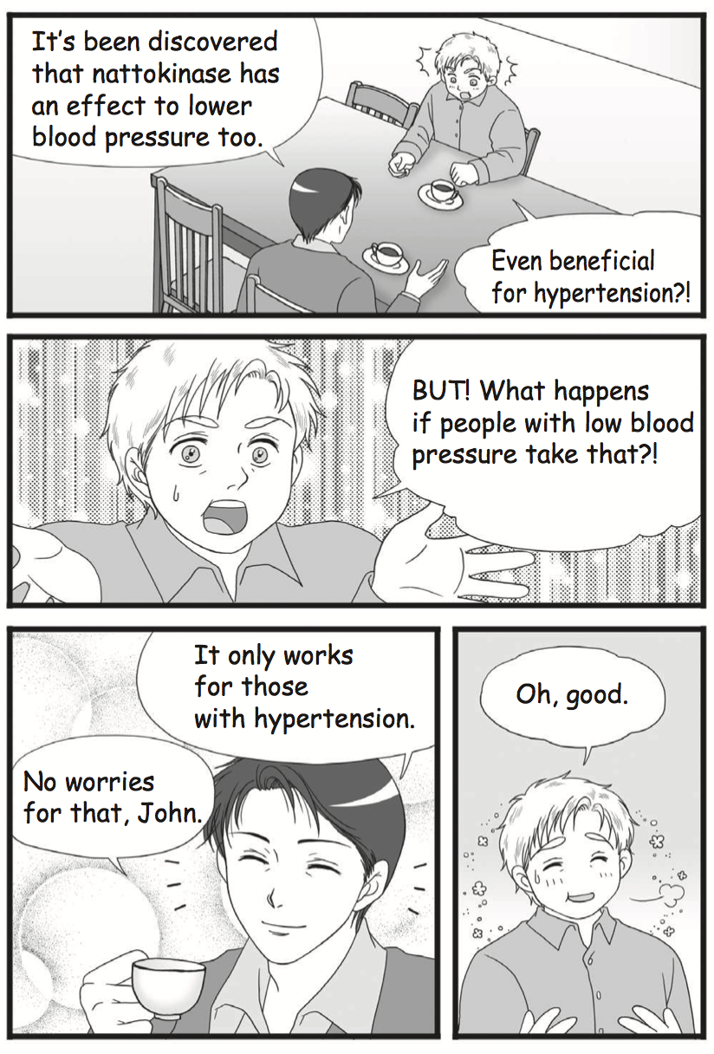
NSK-SD® Reduces Hypertension
SUMMARY
NSK-SD effectively decreases High Blood Pressure
NSK-SD effectively decreases Cardiovascular Risk Factors
NSK-SD is safe for those with normal blood pressure
Notes:
If APTT and PT values are not in normal range, this can mean bleeding problems
Warfarin is a common medicine used as an anticoagulant
PT and INR measures intrinsic pathway for coagulation
APTT measures extrinsic pathway for coagulation
When prescribing Warfarin, the appropriate dosage is determined based off of a target range for APTT (Activated Partial Thromboplastin Time) and PT (Prothrombin Time) to ensure that it is preventing harmful blood clots but not preventing beneficial blood clots involved in wound healing.

Slide 9
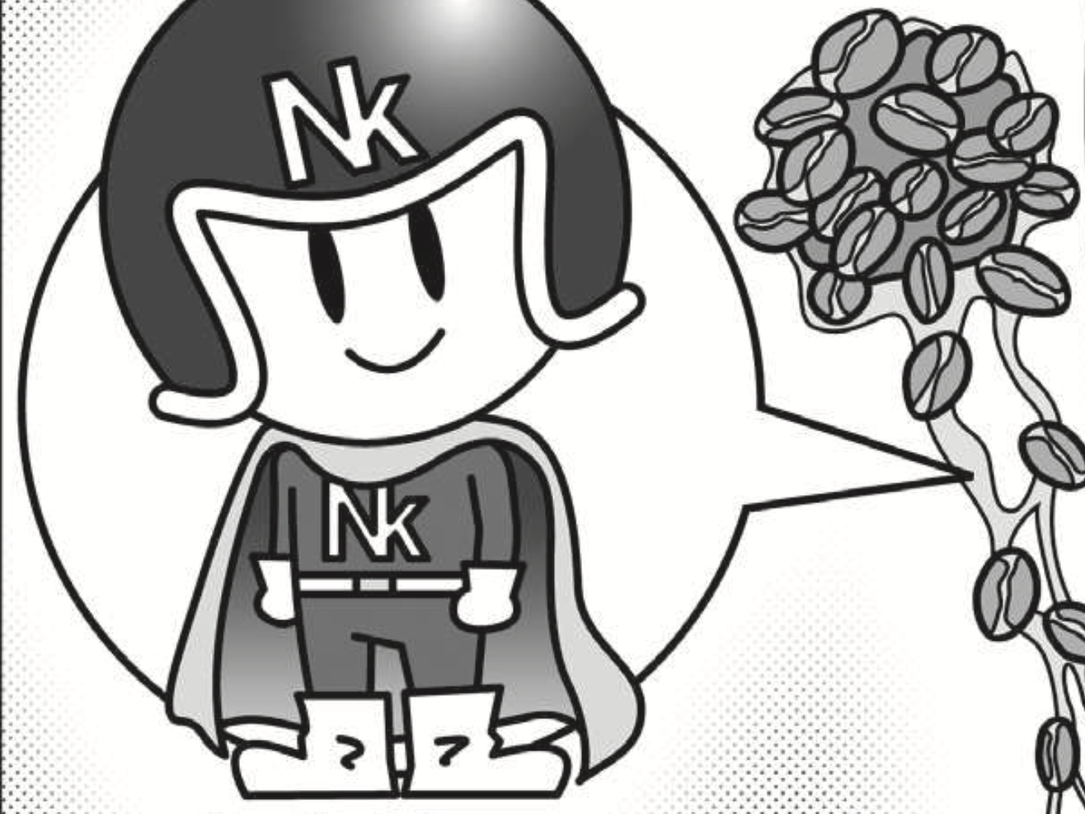
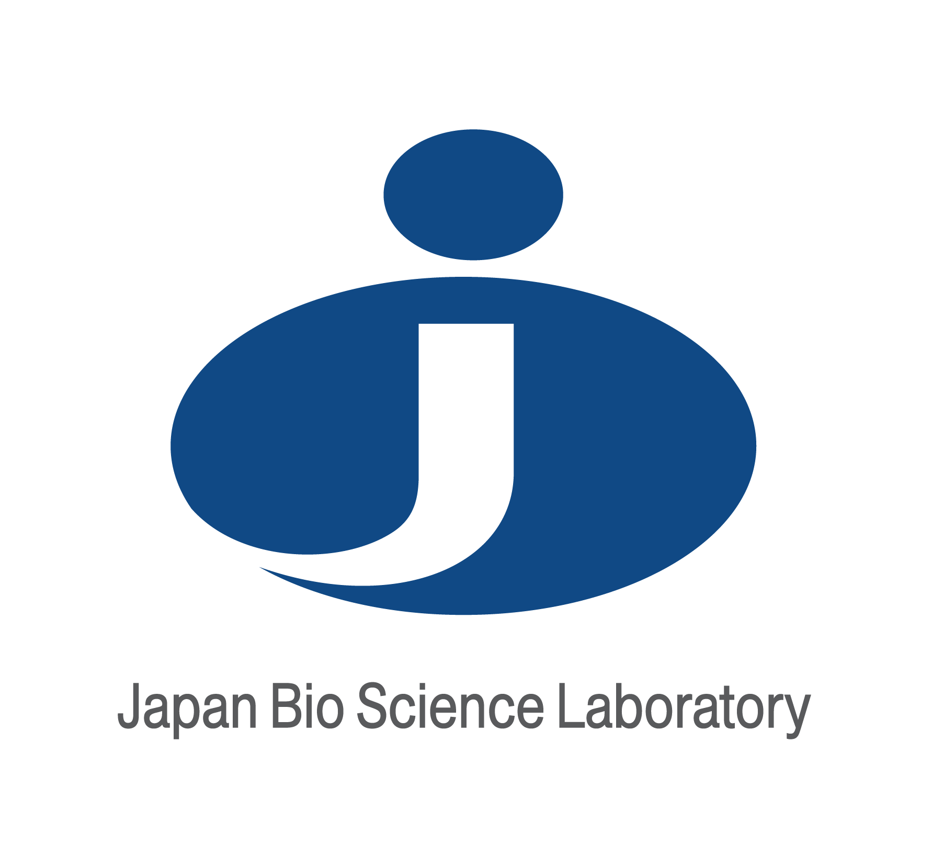
NSK-SD®
THANK YOU!
IF IT’S NOT NSK-SD®, IT’S NOT NATTOKINASE

